Slide 1
Constraints on Positron Flux Contributions from Pulsar Populations MS-PSD Thesis Summary
By Olivia Meredith Bitter, under the supervision of Dan Hooper

Slide 2
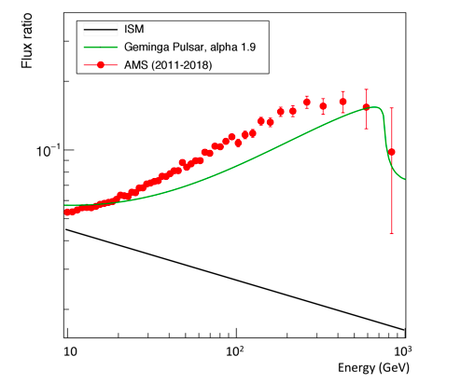
Pulsars and their solution to the positron Excess
Data from AMS-01, HEAT, and PAMELA since the early 2000s have all indicated that there is a substantial deviation in the observed positron fraction, i.e., the ratio of positrons to electrons plus positrons, from the standard interstellar medium (ISM) predictions at energies roughly between 1 - 100 GeV [1, 2, 3].
More recently, data from AMS-02 has shown that this tension is even more noticeable up to at least 1TeV [4, 5].
One such proposal to solve this ongoing tension is to consider pulsars - spinning neutron stars that are magnetized - as a possible source for the observed higher contributions to the positron flux [5].
This is because relatively young and nearby pulsars have high gamma ray emissions as seen in experiments such as HAWC (High Altitude Water Cherenkov) [6].
The gamma ray emission is produced by particles such as positrons that are injected from pulsars into the interstellar medium [7, 8].
The above gives the contribution from only the Geminga pulsar in green (it is in the relatively nearby and young category) to the positron flux ratio with the following parameters: an efficiency of 29 percent, a spectral index of 1.9 and a spectral energy of 50 TeV. The predicted ISM curve is in black and the AMS data is in red for comparison. This plot was recreated to show why relatively nearby and young pulsars could be a possible solution to the tension.
[1] https://link.aps.org/doi/10.1103/PhysRevLett.111.081102.
[2] http://dx.doi.org/10.1016/j.physletb.2007.01.024.
[3] http://dx.doi.org/10.1086/310706.
[4] http://dx.doi.org/10.1103/PhysRevLett.103.051104.
[5] DOI:10.1393/ncc/i2019-19173-y.
[6] http://dx.doi.org/10.3847/1538-4357/aa7556.
[7] http://dx.doi.org/10.1016/S0927-6505(99)00112-7.
[8] http://dx.doi.org/10.1103/PhysRevD.96.103013.

Slide 3
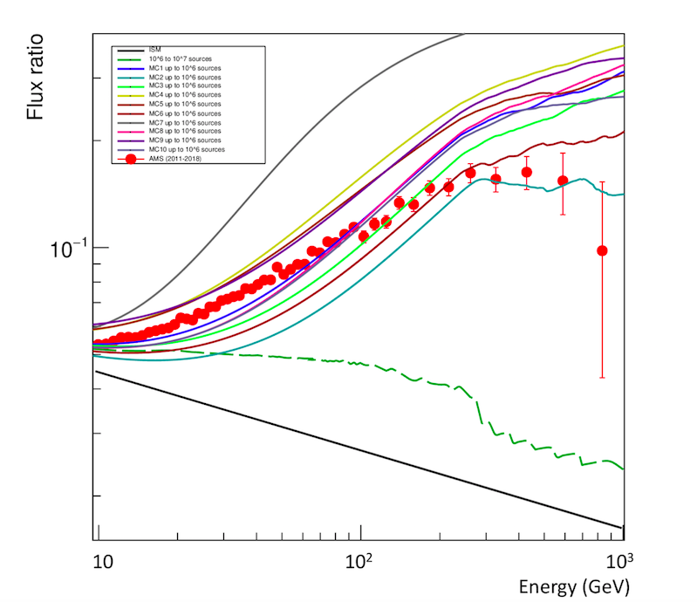
the free parameters for Monte Carlo Simulations
Building upon previous work by Hooper, Linden, and collaborators, this thesis updates and further constrains what characteristics pulsar populations should have in order to contribute the most to the positron flux excess [1,2,3,4,5,6].
In order to further constrain the parameter space on how close to Earth and how young a pulsar is needed to be to contribute meaningfully to the observed excess, I used Monte Carlo simulations (MC) to explore five main parameters that could change the contribution of the positron flux allotted to a given pulsar(s) – leading to a better agreement with AMS data [5,6].
Spin-down time: time interval between injections of particles into the ISM
Efficiency: percent of rotational kinetic energy that the pulsar loses via injecting the particles
Spectral index: an indicator of particle flux density in the power-law distribution concerning frequencies of positrons and electrons
Pulsar birth rate: rate per century of pulsars being born
F_det: fraction of detected pulsars by surveys and catalogued in the ATNF reference [7]. (This one will be utilized on the next slides.)
The above shows the contribution of MC pulsars with one possible set of parameters: an efficiency of 10 percent, a spectral index of 1.9, a spin-down time of 10⁴ years, and a birth rate of 0.3 per century. This distribution highlights pulsars up to 10⁶ years, with the background as the dashed green line of pulsars between 10⁶ to 10⁷ years. The predicted ISM curve is in black and the AMS data is in red. Note that all plots shown in the slides consider only pulsars closer than 3kpc as further sources were found to provide negligible contributions.
[1] https://doi.org/10.1088/0004-637x/772/1/18.
[2] https://doi.org/10.1088/1475-7516/2009/01/025.
[3] arXiv:1705.09293 [astro-ph.HE].
[4] https://link.aps.org/doi/10.1103/PhysRevD.88.023013.
[5] http://dx.doi.org/10.1103/PhysRevD.98.083009.
[6] http://dx.doi.org/10.1103/PhysRevD.96.103013.
[7] http://dx.doi.org/10.1086/428488.

Slide 4
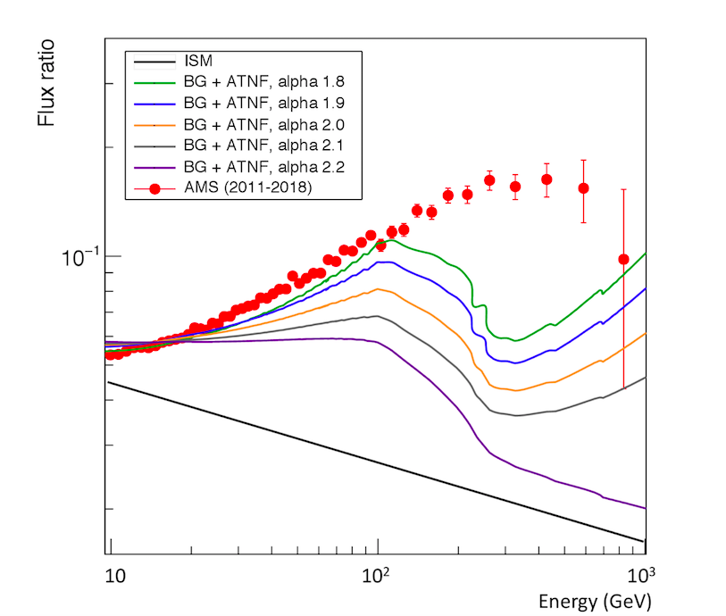
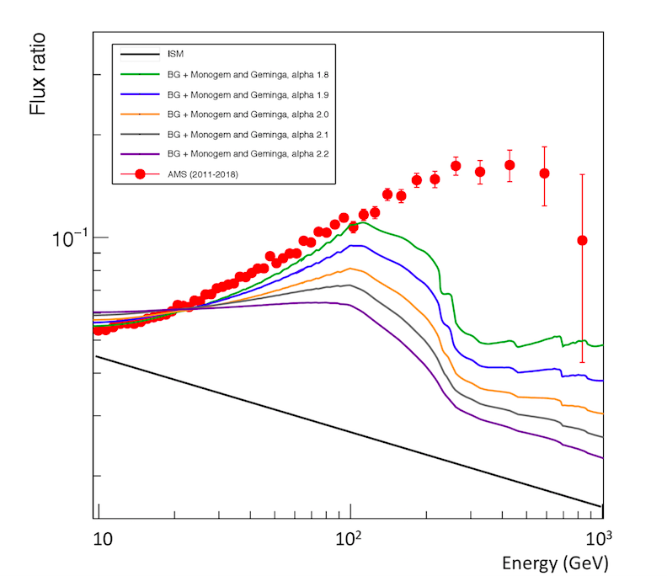
Further constraints on plausible pulsar populations
I then added MC contributions from the background to only known and catalogued pulsars under a given combination of free parameters to probe the variation in the last slide as a case study.
I assumed all pulsars younger than 10⁵ years are known and catalogued by ATNF, then the parameter F_det is one and the pulsar birth rate is 0.673 per century.
I probed various combinations of spin-down time and spectral indices while adjusting the efficiency by normalizing the background (10⁶ to 10⁷ years) and the ATNF pulsar (younger than 10⁵ years) distribution to the AMS data at around 20 GeV. (left panel shows it for 2 x 10⁴ years)
Separately, various combinations of the background (10⁶ to 10⁷ years) was done now with ATNF catalogued pulsars Geminga and Monogem (10⁵ and 10⁶ years). (right panel shows it for 2 x 10⁴ years)
The results indicate that the best fit of free parameters to obtain a good agreement with the AMS data specifically at low to moderate energies is a spin-down time of roughly 2 x 10⁴ years, a spectral index of around 1.8, and an efficiency between 1.75 and 2.5 percent.
Future studies will increase the range of ATNF pulsars up to 10⁶ years to include Geminga and Monogem, as well as to combine these results with MC simulations for consideration.
However, this current analysis continues to provide a strong indication that pulsars could possibly explain the positron excess present in data.
The left panel shows the contribution of both the background (simulated) and the ATNF catalogued pulsars (less than 10⁵ years) to the positron flux ratio for a spin-down time of 2x10⁴ years. The spectral indices range from 1.8 to 2.2. with efficiencies from 2.5 to 0.7 percent respectively.
The right panel shows the contribution of both the background and the Geminga and Monogem pulsars (both within 3 kpc and between 10⁵ and 10⁶ years) to the positron flux ratio for a spin-downtime of 2 x10⁴ years. The spectral indices range from 1.8 to 2.2 with efficiencies from 2.5 to 0.8 percent respectively.
Both have a pulsar birth rate is 0.673 per century and hence f_det is one. The predicted ISM is shown in black and the AMS data is shown in red.

